Slide 1
Business writing layout

Slide 2
Agenda
Introduction
Salutation
Body
Closing
Font
Punctuation
Tips and tricks
Conclusion
QUALITY. PRODUCTIVITY. INNOVATION.

Slide 3
Introduction
Whatever you do – whether you’re a student, employed in an office job, or working as a freelancer – I can guarantee that at some point in your life, you’ll need to sit down and write a formal business letter/email.
Today we’re going to start from the end and go through some basics of formatting you emails/letters.
Layout is the theme of the day !!!
QUALITY. PRODUCTIVITY. INNOVATION.

Slide 4

1. Salutation
Use the name specified in Lync or in the email address(provided you have received on already).
If you know the person and typically address them by their first name, it is acceptable to use more informal ways of salutation (for example: Dear Lucy:).
In all other cases, however, use “Hi Lucy:” or “Hello Lucy,” followed by a colon or comma.
Leave one line blank after the salutation.
QUALITY. PRODUCTIVITY. INNOVATION.

Slide 5
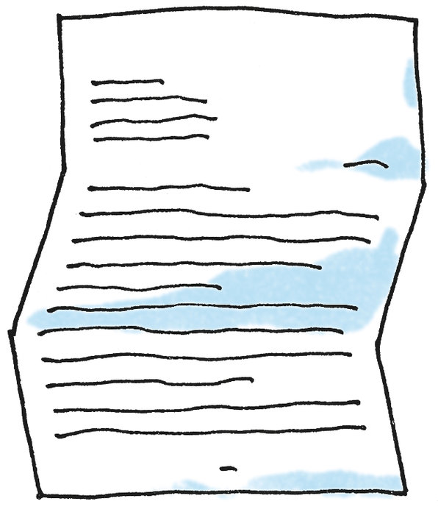
2. Body
Formats
When writing business letters/emails, you must pay special attention to the format, content and font used.
The main formats for business letters used are called full block format and indented format/semi-block format.
QUALITY. PRODUCTIVITY. INNOVATION.

Slide 6
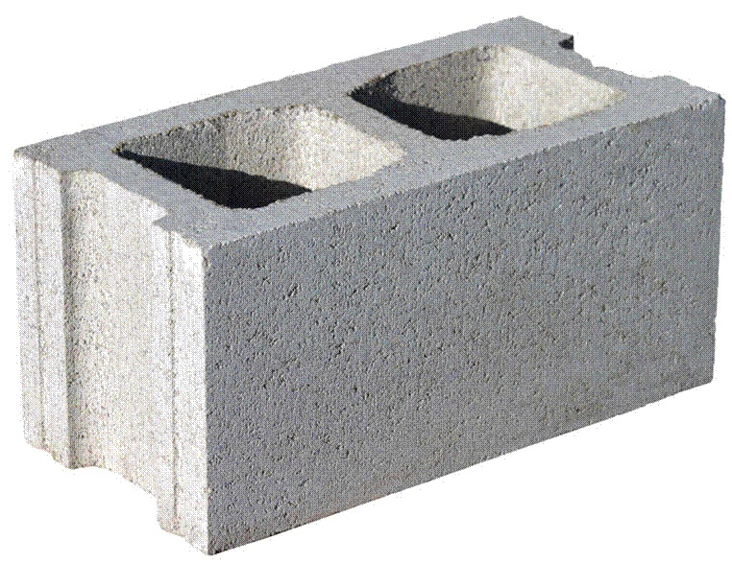
2.1 Block Format
The most common layout of a business letter is known as block format. Using this format, the entire letter is left justified and single spaced except for a double space between paragraphs.
QUALITY. PRODUCTIVITY. INNOVATION.

Slide 7

2.1 Indented Format
Another, least used, style is semi-block. It is much like the modified block style except that each paragraph is indented instead of left justified.
QUALITY. PRODUCTIVITY. INNOVATION.

Slide 8

2.2 Body
Paragraphs
The specific content of the letter will be created to meet the needs of the situation, but the structure of any letter/email should meet certain expectations:
QUALITY. PRODUCTIVITY. INNOVATION.

Slide 9

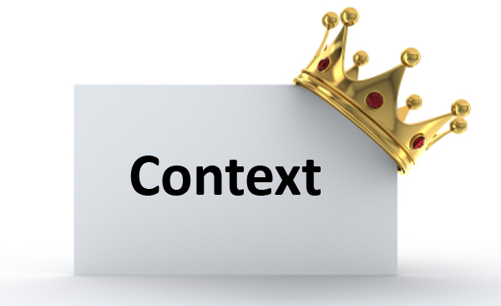
2.2 Context Paragraph
The first paragraph of the letter will define the context, providing a clear statement of the letter’s topic and purpose.
Avoid starting a letter with legalistic or flowery language that doesn’t explain what the letter is about.
The bureaucratic, “Pursuant to your recent letter of request, we are hereby responding with the information you requested,” for example, offers no information at all about the content or purpose of the letter.
QUALITY. PRODUCTIVITY. INNOVATION.

Slide 10
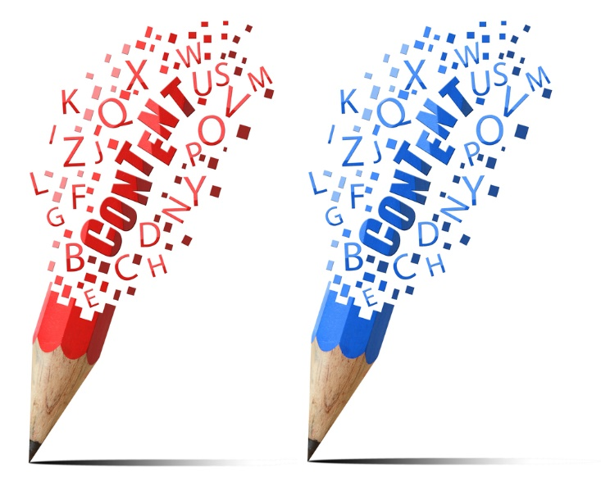
2.2 Content Paragraphs
Use this paragraph to provide the information relevant to its purpose. Each paragraph should cover a single topic or point. In the case of a long letter that covers multiple pages, it is appropriate to break the information into two or more emails with each one covering a specific topic.
QUALITY. PRODUCTIVITY. INNOVATION.

Slide 11


2.2 Action Paragraph
The final paragraph of the letter provide a clear, straightforward statement of the action that will be taken by the writer, requested of the reader, or expected by a third party.
QUALITY. PRODUCTIVITY. INNOVATION.

Slide 12

Closing
Close your letter traditionally for formal communications and with first-time recipients, using a closing such as "Sincerely," "Kind regards," or "Thank you."
If you have established good communication with your recipient, follow-up emails closed with less formal terms such as "Best," or "Thanks," are often appropriate
QUALITY. PRODUCTIVITY. INNOVATION.

Slide 13
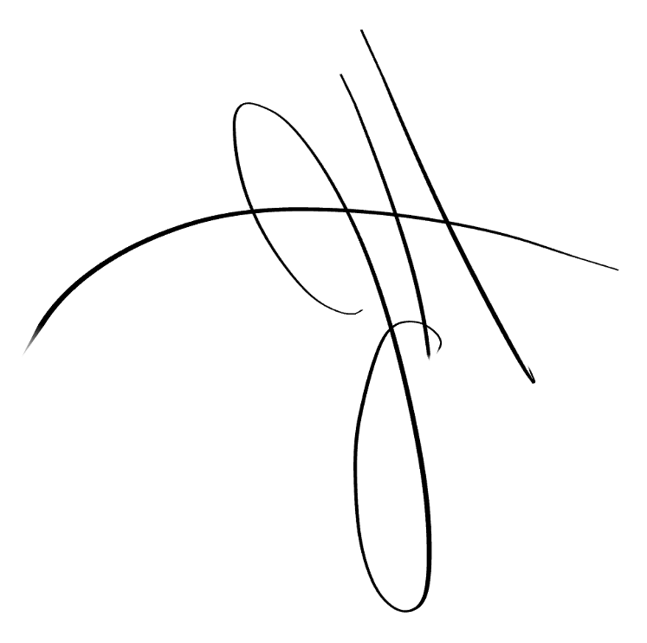
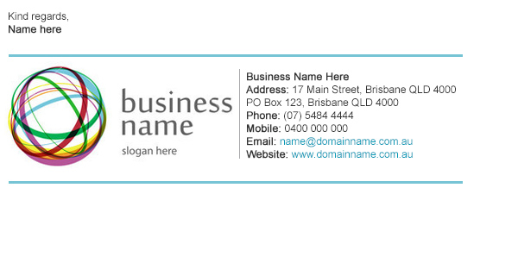
Closing
Type your full name under the closing for a first email and include your title or position under your name. Omit your last name in subsequent emails for a friendlier tone.
Insert a company signature under your name and title. The email signature replaces a letterhead in a print letter. You can also include your email address, website address and cell phone number.
QUALITY. PRODUCTIVITY. INNOVATION.

Slide 14
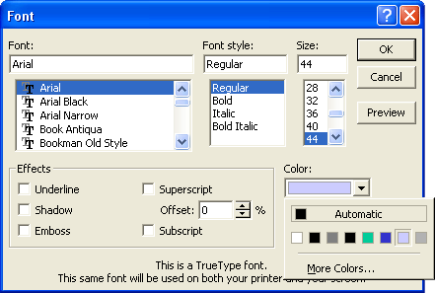
Font
Another important factor in the readability of a letter is the font.
The generally accepted font is Times New Roman, size 12, although other fonts such as Arial may be used. When choosing a font, always consider your audience.
If you are writing to a conservative company, you may want to use Times New Roman.
However, if you are writing to a more liberal company, you have a little more freedom when choosing fonts.
QUALITY. PRODUCTIVITY. INNOVATION.

Slide 15
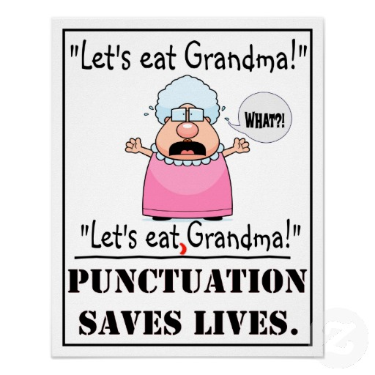
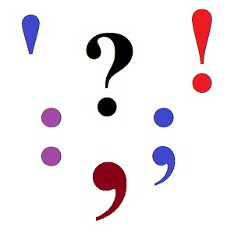
Punctuation
Punctuation after the salutation and closing - use a colon (:) after the salutation (you may use a comma as well) and a comma (,) after the closing.
In some circumstances, you may also use a less common format, known as open punctuation. For this style, punctuation is excluded after the salutation and the closing.
QUALITY. PRODUCTIVITY. INNOVATION.

Slide 16

Tip time !
First - Avoid sloppiness.
Second - Capitalize the first letter in the beginning word of a sentence and in all proper nouns.
Third - Avoid shouting; you can be heard without raising your voice.
Fourth - Use abbreviations and acronyms sparingly.
Fifth - Avoid using emoticons; they're too cute for serious business email.
Sixth - Write in short paragraphs.
Seventh - Stick to one topic.
Eight - Answer your email.
QUALITY. PRODUCTIVITY. INNOVATION.

Slide 17

Layout
The look of a page is important.
Show the reader the underlying structure of your writing by using headings, lists and other good techniques of white space.
Show the reader your organization and helps him be organized.
There are three layout techniques:
    Use short paragraphs
    Use headings
    Use bullets and other lists
QUALITY. PRODUCTIVITY. INNOVATION.

Slide 18
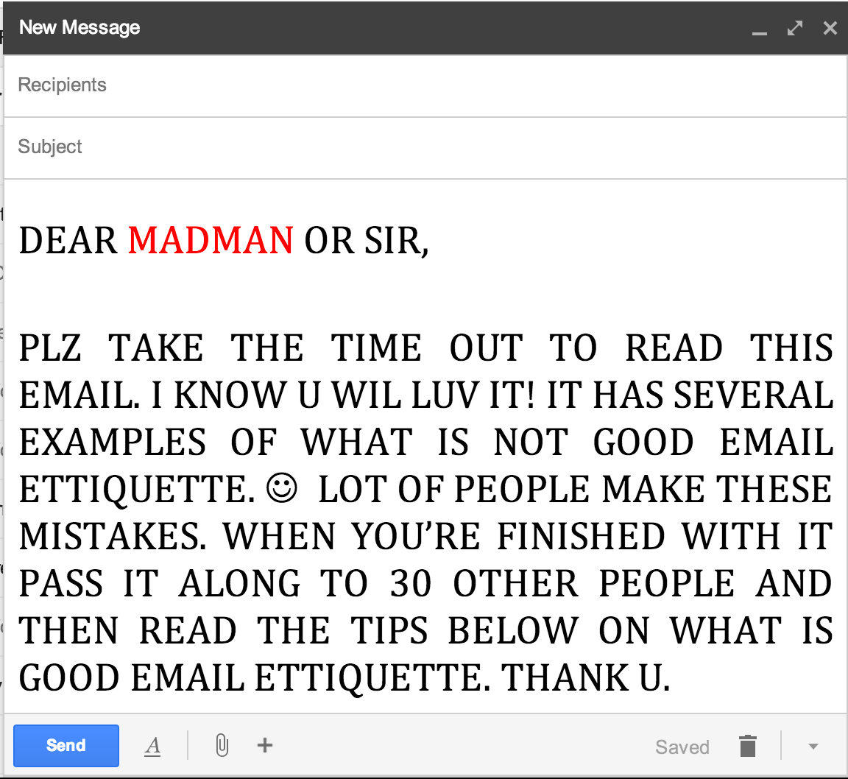
Example
QUALITY. PRODUCTIVITY. INNOVATION.

Slide 19
Thank you!
Muraseva Iulia
  AM Analyst
QUALITY. PRODUCTIVITY. INNOVATION.

